Slide 1
Welcome to FinTech!
Lesson 1.1

Slide 2

Notes:
Welcome!
Meet the team:
Student Success Manager
Program Director
Student Services Director
Career Director
Students
TAs
Instructor

Slide 3
Class Objectives
By the end of today’s class, you will:
Get to know the instructional team as well as each other.
Become familiar with the course format and requirements for certification.
Review the course topics and agenda.
Be able to explain what FinTech is.
Review the completion and submission guidelines for the Unit 1 homework assignment.

Slide 4
Defining FinTech

Slide 5

Notes:
Image source: shutterstock_713071012

Slide 6

The Financial Sector Today
Tech Firms Could Pose Major Threat to Banks
Why Big Banks Are Losing to Tech Giants Over Open Banking
Worldwide Financial Services External and Internal IT Spending to Reach $500 Billion in 2021, According to IDC Financial Insights
Banks Unveil Network to Digitize Trade Finance
How Technology Is Impacting the Finance and Banking Sector
The Future of Banking Is Rapidly Becoming a Digital Domain. How Will Community Banks Respond to the Tide of Technology?
Why Top Tech Talent May Be Coming to Finance
Blockchain Technology Is Helping Small Businesses Create Their Legal Agreements
“Banks Are Technology Firms”
Notes:
Image source: AdobeStock_225331168

Slide 7
What Is FinTech?
The broader FinTech category can be segmented into four variants.
Origin | Technology | Infrastructure providers seeking to help financial institutions digitize and modernize their technology stacks. Examples: FNZ, Marqeta, Onfido | Large technology ecosystems using financial services to strengthen relationships with users. Examples: Apple, Ant Financial, Tencent
 | Financial Services | New entrants, start-ups, and attackers seeking to enter financial services using new technologies. Examples: SoFi, TransferWise, LendingClub | Incumbent financial institutions making significant investments in technology to lift their game. Examples: Wells Fargo, Ping An
 |  | Low (small scale) | High (large scale)
 |  | Scale

Slide 8

But what exactly is FinTech?
Notes:
Image source: AdobeStock_251182451

Slide 9
FinTech is the combination of finance and technology. More specifically, it describes a financial services industry that has been disrupted by technological innovation that competes with traditional financial methods and improves activities and inefficiencies in finance.

Slide 10
Course Overview

Slide 11
Curriculum Overview
Intro to FinTech First, you’ll learn about the fundamental priorities of investment banks, traders, insurance agencies, and other players in the financial industry. You will also learn about the command line and GitHub to prepare for future programming assignments.
Python and Financial Programming Next, you’ll learn Python programming, focusing in-depth on the core libraries relevant to finance work. You will use APIs like Quandl to add live financial data feeds to your software projects. You’ll also use a variety of analytic tools to extract insights and create reports.

Slide 12
Curriculum Overview
Algorithms, Statistics, and Machine Learning You will learn a variety of core algorithms, models, and forecasting tools, including Monte Carlo simulations, risk-data aggregation, portfolio theory, and regression. You’ll draw on this background as you apply machine learning concepts to financial challenges.
Advanced Topics: Big Data and Blockchain The course will end with deep coverage of the big data and blockchain toolchains. You will use Python to complete challenges that involve building and using these toolchains for financial and regulatory benefit.

Slide 13
Curriculum Breakdown by Week
Unit 1: Intro to FinTech
1. Intro to FinTech and Finance
Units 18–22: Blockchain Deep Dive
18. Intro to Blockchain
19. Interacting with Blockchains in Python
20. Intro to Solidity & Smart Contracts
21. Advanced Solidity & Smart Contracts
22. Blockchain Application Development
Units 2–7: Python for Finance Deep Dive
2. Python Basics
3. Python and Pandas + Review Day
4. Pandas + Review Day
5. APIs
6. Data Visualization
7. SQL
Units 23–24: Project Work
23. Project 3
24. Project 3 continued
Units 8–9: Project Work
8. Project 1
9. Project 1 continued
Core Program Modules
Units 10–15: Applied Machine Learning
10. Time Series Analysis
11. Classification
12. AWS and Cloud ML
13. Natural Language Processing
14. Deep Learning and Robo Advisors
15. Algorithmic Trading
Python
Applied ML and AI
Blockchain / Cryptocurrency
Units 16–17: Project Work
16. Project 2
17. Project 2 continued

Slide 14
Hard Skills + Core Knowledge = Real Jobs
Skills/Technologies Covered
Relevant Jobs
Time-Series Analysis
Financial Ratios / Analysis
Python Programming
API Interactions
Pandas
NumPy / SciPy
Pyfin
Quant DSL
SQL
Monte Carlo Simulations
Forecasting
Modern Portfolio Theory
Machine Learning
Big Data
Blockchain / Cryptocurrency
Business Analyst
Financial Analyst
Data Analyst
Data Scientist
Quantitative Trader
Systems Business Analyst
FinTech Regulatory Associate
Software Developer
Financial Manager
Business Intelligence Analyst
Cryptocurrency Expert
Blockchain Developer

Slide 15
Sample Homework Assignments

Slide 16

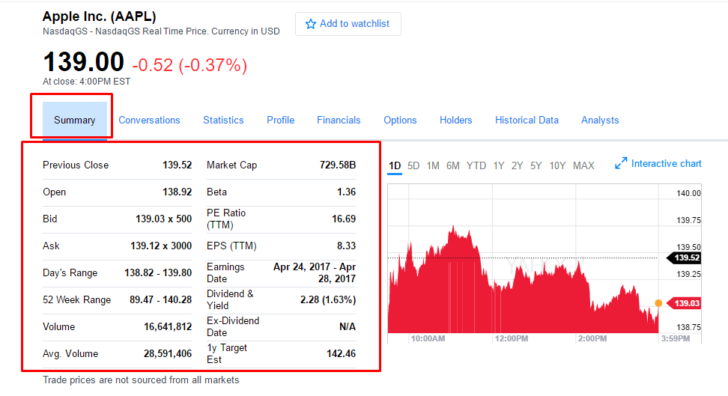
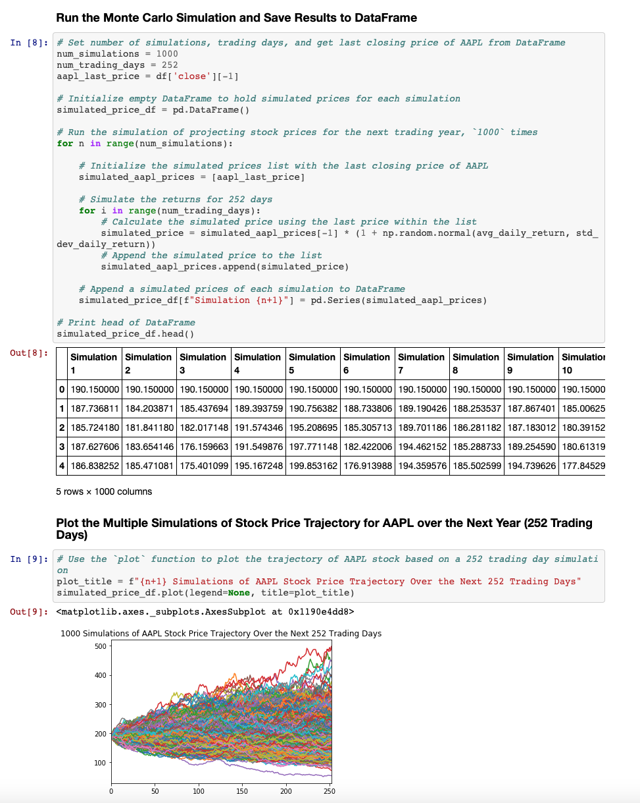
Sample Assignment: Risky Business (APIs and Statistics)
You will learn to create live applications that draw stock data using the Financial APIs to power Jupyter notebooks to analyze stock movement.
Notes:
Image on right from Yahoo Finance (2019): https://finance.yahoo.com/quote/AAPL?p=AAPL&.tsrc=fin-srch

Slide 17
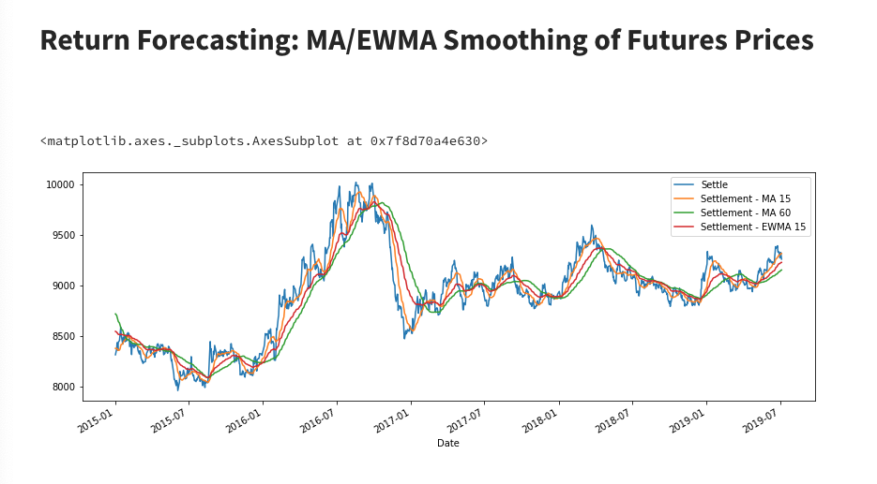
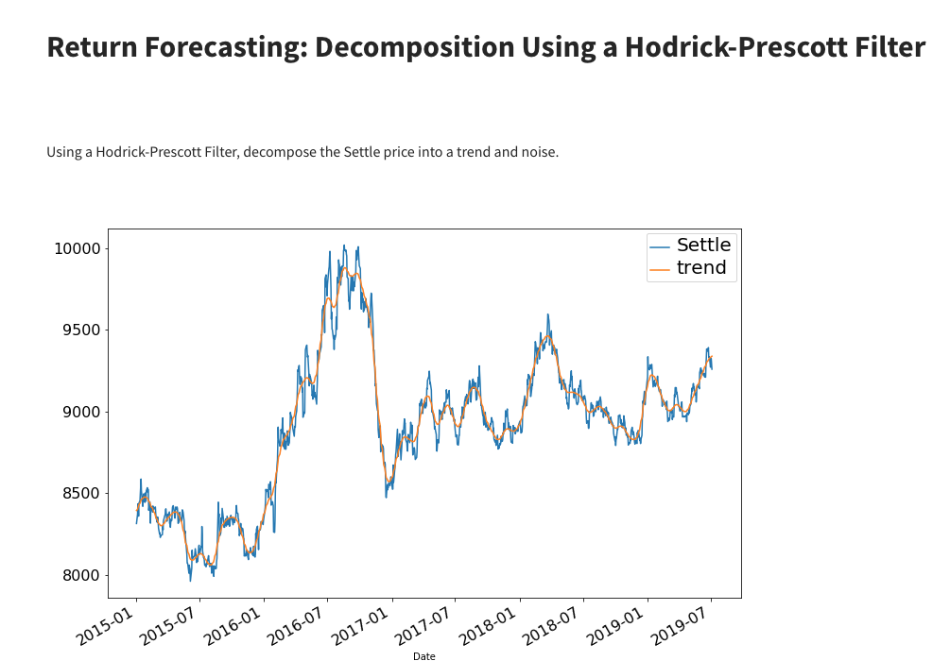
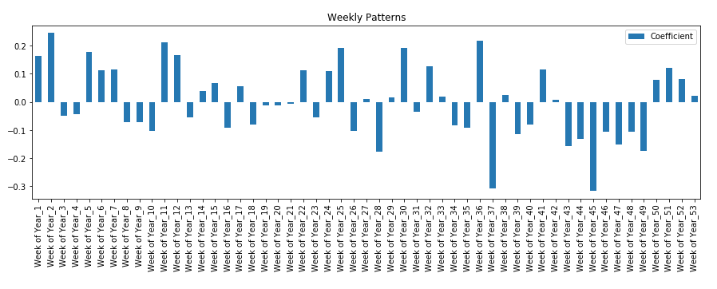
Sample Assignment: Stock Forecasting (Python & Time Series Analysis)
You will learn to create predictive models for stock prices using time series analysis and disparate variables.

Slide 18
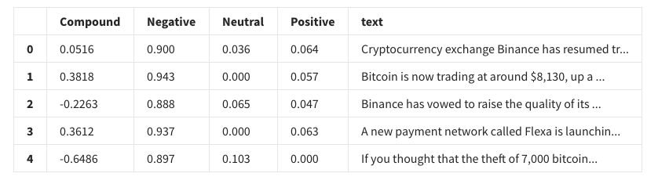
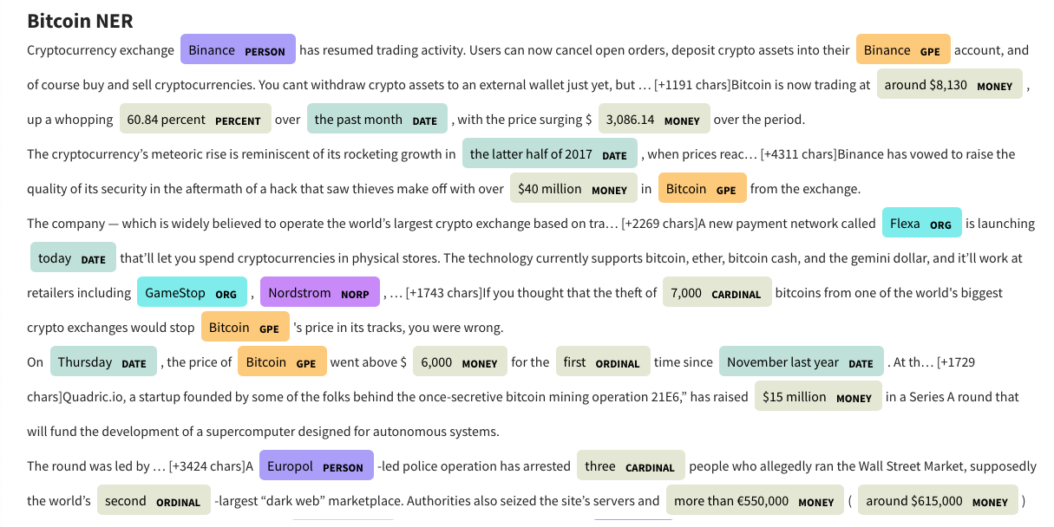
Sample Assignment: Crypto Sentiment (Machine Learning)
Throughout the course, you will learn the basics behind the most common machine learning techniques (linear regression, logistic regression, KNN, k-means clustering, etc.) and how to apply these algorithms to classic challenges in the financial services sector, such as applying Natural Language Processing to analyze sentiment scores for Cryptocurrency news.

Slide 19
Tips

Slide 20

Embrace your inner toddler.
Notes:
Image source: shutterstock_667830277

Slide 21

Brace yourself for doubt, challenge, and confusion.
Notes:
Image source: AdobeStock_177436300

Slide 22

Relish the novice experience and expect a lot of lightbulb moments.
Notes:
Image source: shutterstock_1191758596

Slide 23

Form a community with your classmates.
Notes:
Image source: shutterstock_137111177

Slide 24

There is no shortcut.
You’ve got to put in the hours!
Notes:
Image source: shutterstock_564194332

Slide 25

Celebrate
your successes!
Notes:
Image source: AdobeStock_79692824

Slide 26

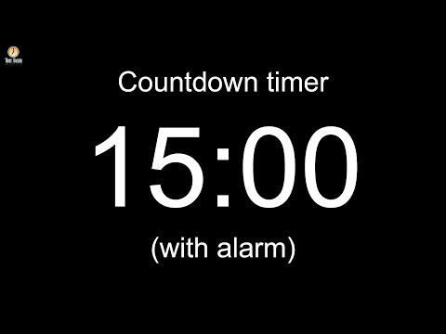
Notes:
Image source: AdobeStock_56885471

Slide 27
The Rise of FinTech

Slide 28
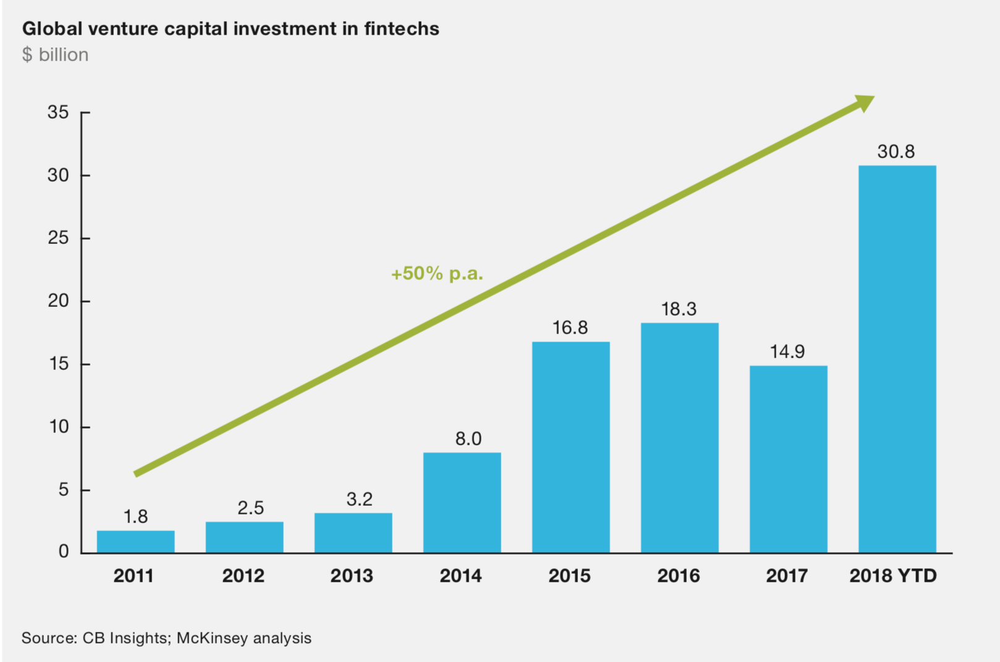
Global FinTech Investment Growth
FinTech investment has shown dramatic growth in recent years.

Slide 29
Why is FinTech such a hot field of study these days?

Slide 30

Explosive Growth in Digitized Data (Creation)
Notes:
Image source: shutterstock_196005458

Slide 31

Explosive Growth in Analytic Tools (Synthesis)
Notes:
Image source: shutterstock_746652745

Slide 32
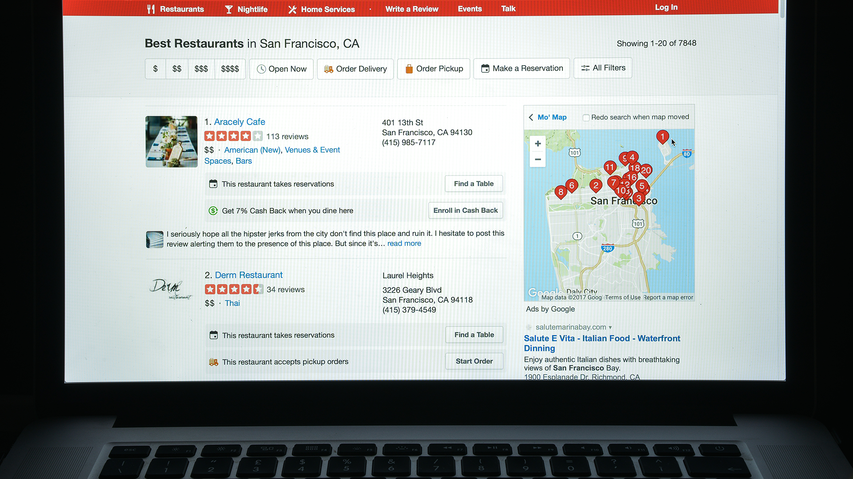
Accelerating Search for Actionable Insight (Value)
Notes:
Image source: shutterstock_703232770

Slide 33
The Driving Forces of FinTech
Driving Technologies
FinTech is driven by the same trends that dominate software and consumer technology.
Artificial Intelligence
Blockchain
Mobile Technology
Machine Learning
Cryptocurrency
Cloud / Dev Ops
Big Data
IoT
IT Security

Slide 34
The Driving Forces of FinTech
Target Industries
Driving Technologies
Regulation
Corporate Accounting
Personal Finance
Corporate Finance
Insurance
Investment Banking
Public Accounting
Artificial Intelligence
Blockchain
Mobile Technology
Machine Learning
Cryptocurrency
Cloud / Dev Ops
Big Data
IoT
IT Security

Slide 35
FinTech Thought Experiments

Slide 36
Activity: FinTech and Me
In this activity, you will reflect on what FinTech means to you.
(Instructions sent via Slack.)
5 Minutes

Slide 38
Activity: Alpacalypse Now
In this activity, you will work in groups to define and articulate the challenges faced by the Altruistic Alpacas charity.
25 Minutes

Slide 39

Activity: Alpacalypse Now
The Client:
Altruistic Alpacas is a charitable organization based in Zanesville, Ohio.
Its mission is to provide alpacas to impoverished areas of the world by empowering people to donate them directly.
Alpacas provide fiber (wool/yarn), meat, milk, and leather, and are a phenomenal way to provide relief to areas of the world that need it.
In the past few months, Altruistic Alpacas have generated a lot of buzz, and donations have started to pour in.
Notes:
shutterstock_468051026
shutterstock_441287701

Slide 40

Activity: Alpacalypse Now
The Situation:
Altruistic Alpacas has a great mission and lots of buzz, but no plan to execute.
While they received a lot of initial donations, they had no clear system for sending alpacas to the correct locations. Donations are being returned to their office in Zanesville! Alpacas are literally piling up in the office, spitting on the interns, and eating all the donuts!
Additionally, donors have no way of knowing if their alpaca was actually delivered. Recipients have no clear global marketplace to sell alpaca wool, and Altruistic Alpacas has not established a system for monitoring the impact of its work.
Altruistic Alpacas is on the brink of collapse!
Notes:
shutterstock_468051026
shutterstock_441287701

Slide 41
Activity: Alpacalypse Now
The Need:
Altruistic Alpacas is looking to solve 5 key problems that currently jeopardize their organization.
Analyze the Need: Where should the alpacas be sent in order to do the most good?
Mo Money, Mo Problems: How does the charity purchase alpacas with donation money? What would be different if it purchased the animals near the local economies?
Alpaca Your Bags: How can the charity ensure that the alpacas arrived at the correct destination?
Wool You Buy This? Where can the recipients of alpacas sell alpaca wool?
Shear Scale of Impact: Did the alpaca donations actually have a positive impact?
With your group, analyze these 5 key areas and identify the technical and financial challenges associated with each problem. If you can, offer a potential solution.

Slide 43
Review Alpacalypse Now

Slide 44
Analyze the Need
(Where should we send the alpacas?)

Slide 45
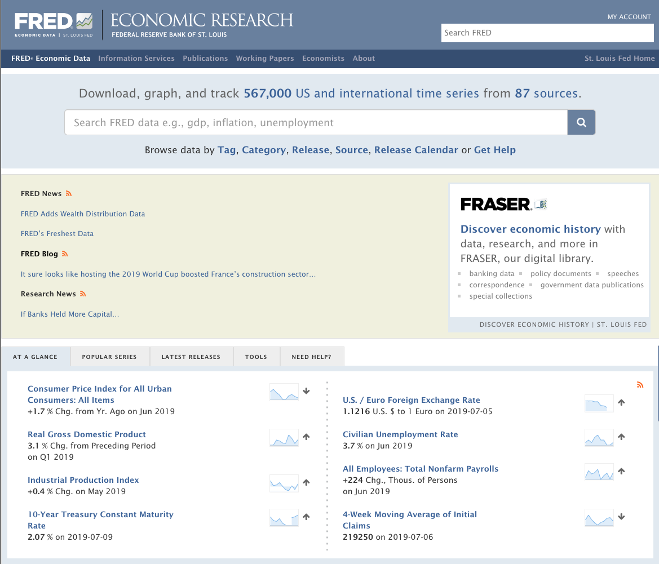
Step 1: Identify Data Sources
Web services like FRED (Federal Reserve Bank of St. Louis)
provide economic data and indicators that cover banking, business, consumer price
indexes, employment, population, GDP, and more.
Notes:
Screenshot from Yelp considered “low-risk”

Slide 46

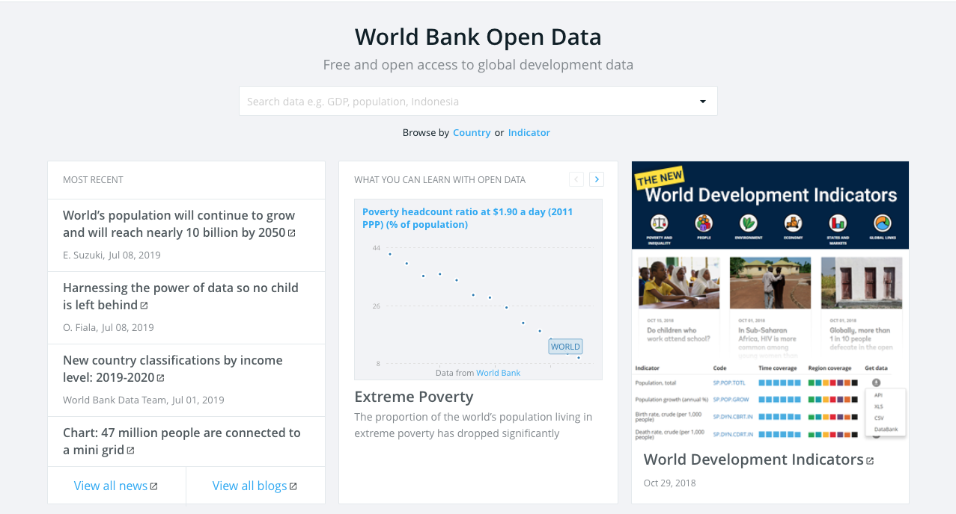
Step 1: Identify Data Sources
Lots of Data!
Notes:
Screenshot from yelp considered “low-risk”

Slide 47

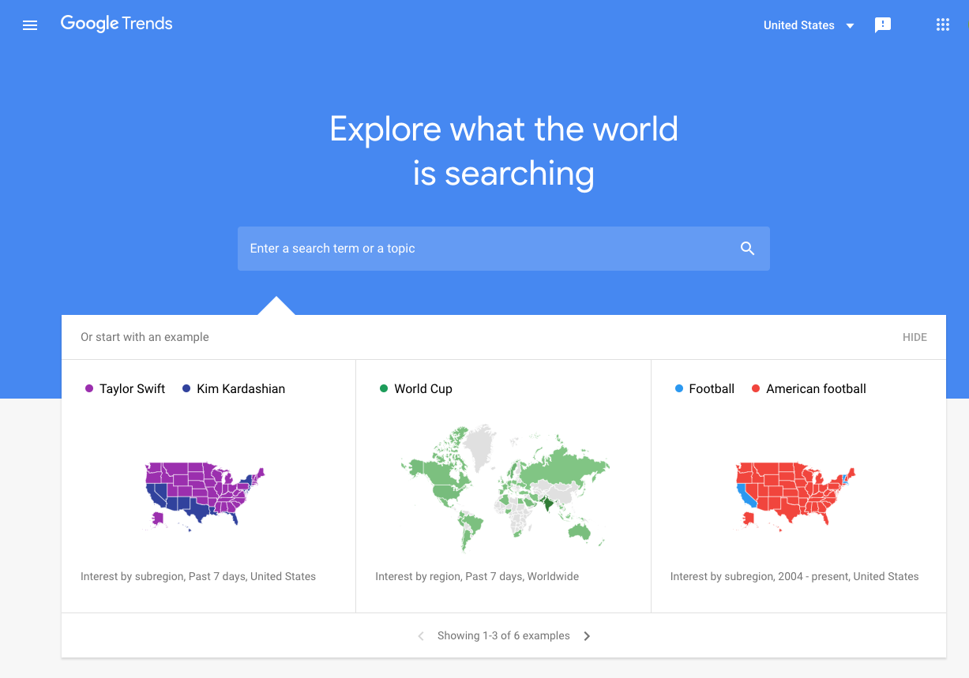
Step 2: Build a Data Retrieval Plan
We could retrieve this data by brute force, but it would be:
Extremely time consuming
Skewed by our city familiarity
Labor intensive
Notes:
Screenshot from yelp considered “low-risk”

Slide 48
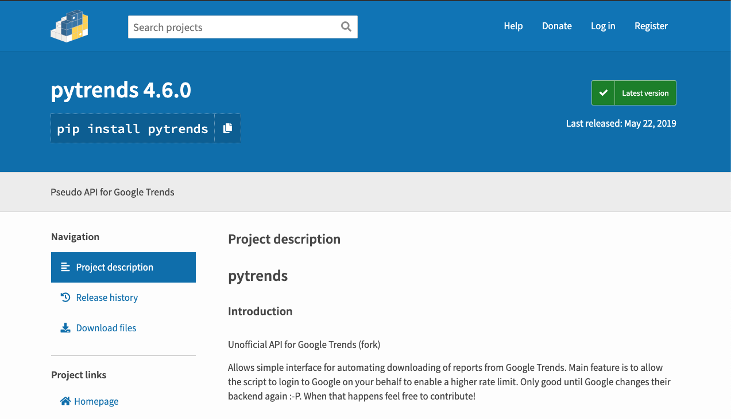
Step 2: Build a Data Retrieval Plan
Thankfully, we can take advantage of the pytrends API to programmatically run our queries. (#ThankGoodnessForProgramming)
Notes:
Screenshot from yelp considered “low-risk”

Slide 49
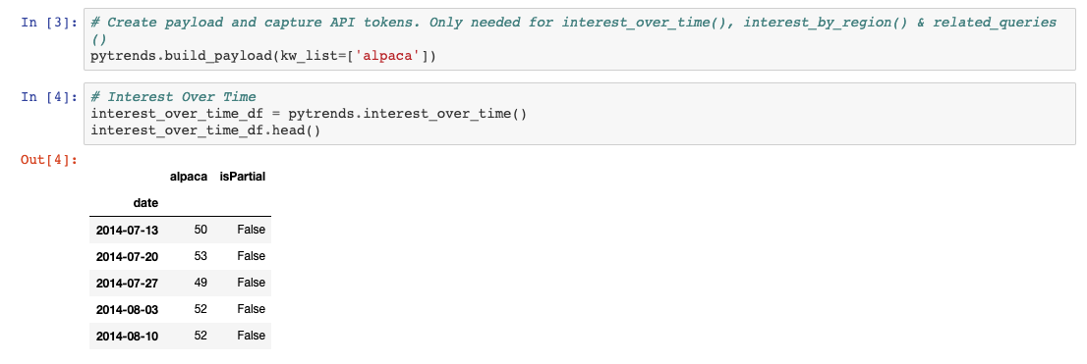
Step 3: Retrieve the Data with Python
This funky code will search Google trends for “alpacas” and return the data...
Notes:
Screenshot from yelp considered “low-risk”

Slide 50
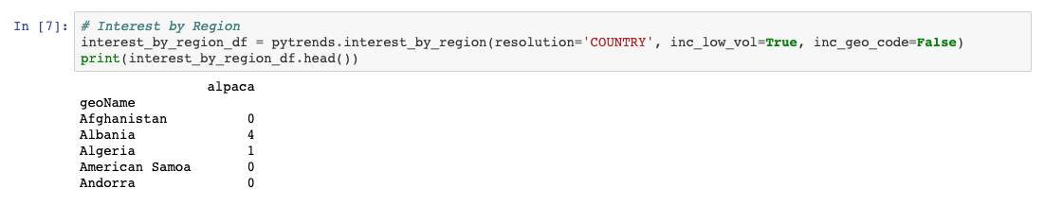
Step 4: Assemble and Clean the Data
...which we can clean up, and then group results by country...
Notes:
Screenshot from yelp considered “low-risk”

Slide 51
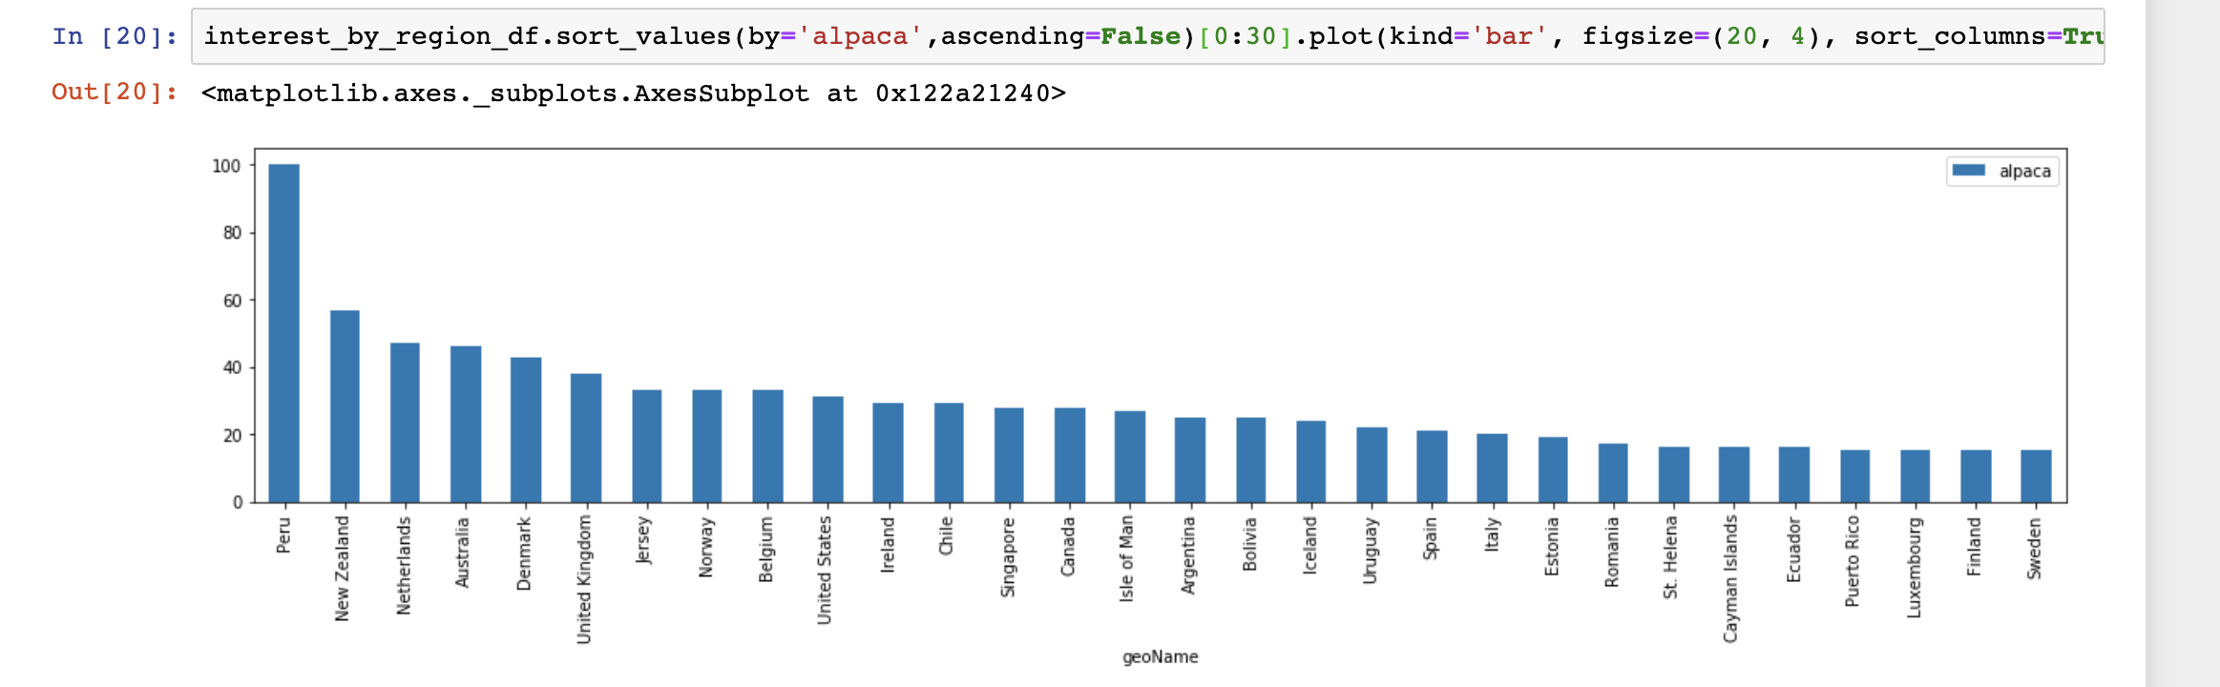
Step 5: Analyze for Trends
Finally, we can visualize the trends and see that Peru is the best location based on search trends. Obviously, there are other factors to consider, but we are rolling with this for now!
Notes:
Screenshot from yelp considered “low-risk”

Slide 52

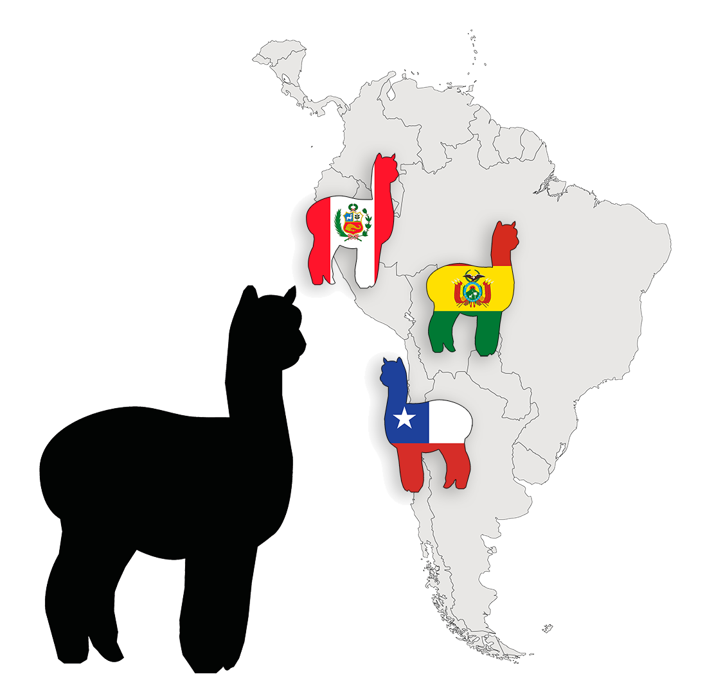


Bonus: Apply Machine Learning!
Deep Learning
We could also apply machine learning to convert economic factors into probable locations.
Notes:
Shutterstock_1053709733
shutterstock_1216392520

Slide 53
Mo Money, Mo Problems
(How do we purchase animals with donation money?)

Slide 54

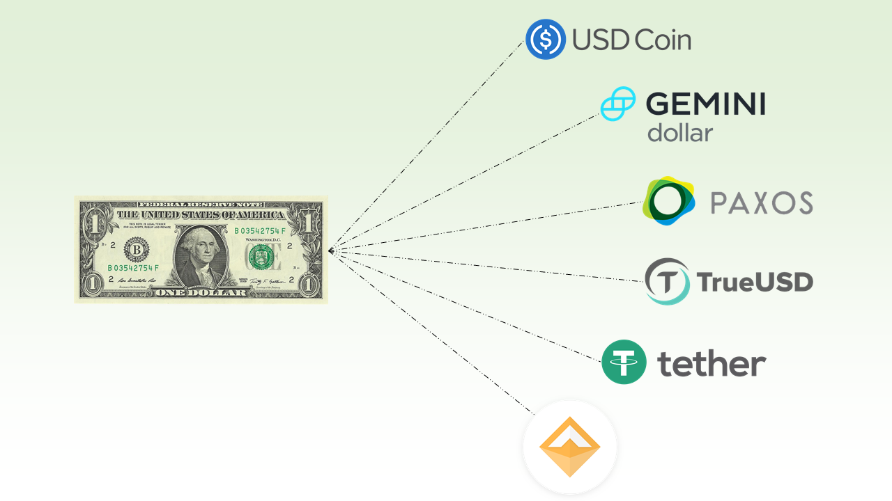
Cross-Border and Localized Payments
How do we move money easily in places where banking infrastructure is not stable?
Cryptocurrencies have provided a way to easily move value between borders. This is valuable in environments where the financial infrastructure is either unstable or nonexistent.
Stablecoins have provided a way to use blockchain technology without volatility.
Notes:
shutterstock_715695178

Slide 55
Alpaca Your Bags
(Did the animal arrive at the destination?)

Slide 56
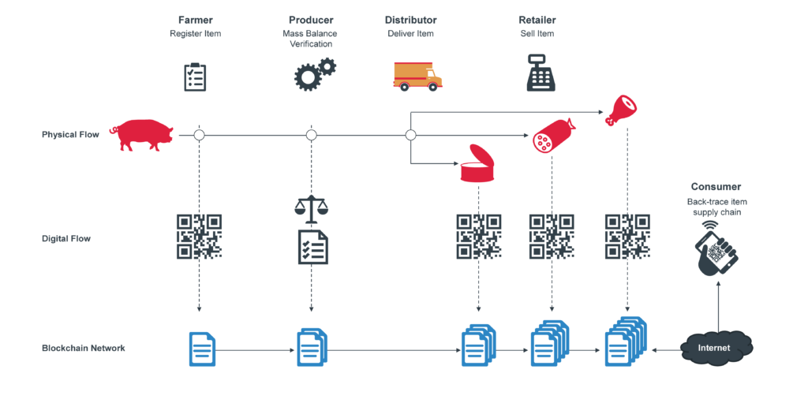

Blockchain Logistics
We can address accountability, governance, transparency, and efficiency with cutting-edge DeFi technology
By targeting the supply chain and leveraging blockchain technology, we can trace the impact of the strategy from the initial donation to the event itself.
Notes:
DeFi = decentrilized finance

Slide 57
Wool You Buy This?
(How does the recipient sell the alpacas’ wool?)

Slide 58



Mobile and Online Merchants
Using DeFi technologies, anyone, anywhere can become their own merchant and be their own bank.
By creating an online marketplace, wool harvests can be sold cross-border and locally without any intermediaries.
Anyone can become their own merchant with just a cell phone.
This enables new economic activity and encourages market growth.
Notes:
Shutterstock_567407257
shutterstock_232609255

Slide 59
Shear Scale of Impact
(Did the donation actually help?)

Slide 60

Analyzing Socio Economic Impact
We can use similar techniques to examine the effectiveness of the charity.
Analyze Wool Sales in the Region
Analyze Economic Indicators
Notes:
shutterstock_744407434

Slide 61
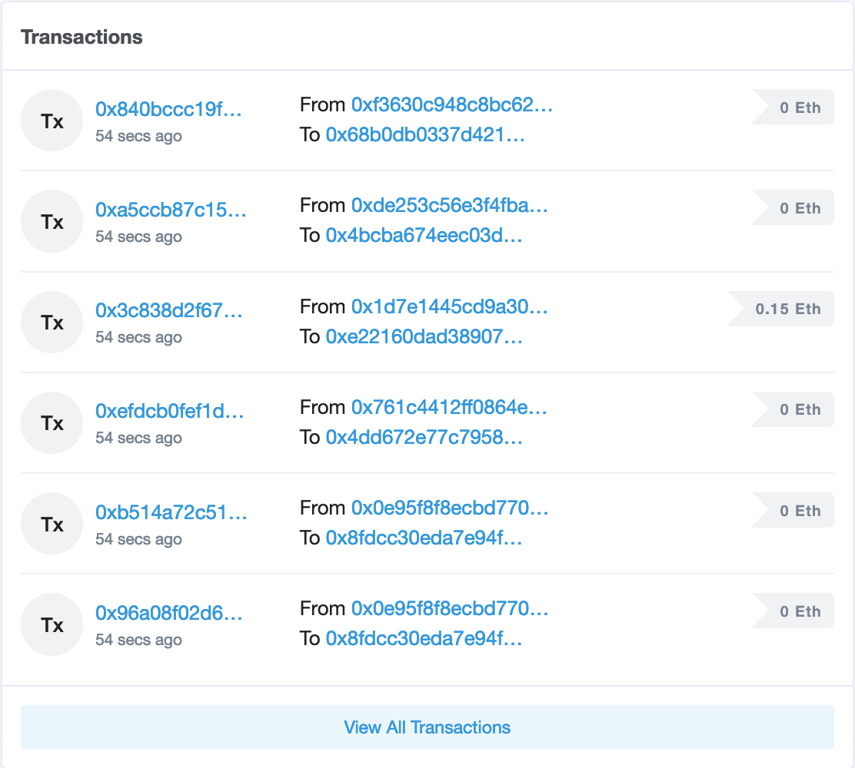

Tracking Transactions
By leveraging DeFi technologies, you can examine blockchain data and analyze the transaction flow.
You can analyze volume and transaction flow in the region with the wool purchases from the online and peer-to-peer markets.
Proof can be embedded into the transaction.

Slide 62
Homework: FinTech Case Study
In this homework assignment, you will develop a case study for a particular FinTech company or technology.
(Instructions sent via Slack.)
August 3rd

Slide 63
Questions?

